Slide 1
BH Astrophys. Ch4 Intermediate Mass Black Holes

Slide 2
Outline
1. The definition
Possible candidates:
2. ULXs (Ultra-luminous X-ray sources) in star-forming galaxies
3. Globular cluster cores in our Milky Way and Andromeda
4. Possible IMBH near the center of the Milky Way
5.Low-luminosity Hard X-ray/radio sources in the galactic bulge and other population II systems

Slide 3
Outline
1. The definition
Possible candidates:
2. ULXs (Ultra-luminous X-ray sources) in star-forming galaxies
3. Globular cluster cores in our Milky Way and Andromeda
4. Possible IMBH near the center of the Milky Way
5.Low-luminosity Hard X-ray/radio sources in the galactic bulge and other population II systems

Slide 4
the definition
Stellar mass BH 5~15$M_{⨀}$
(popIII stars may form ~50 $M_{⨀}$ BHs)
SMBHs: ${10}^{5}\sim {10}^{10}M_{⨀}$
Intermediate mass black holes M~ 50-${10}^{4}$ $M_{⨀}$
Each galaxy may have many IMBHs as isolated objects, in exotic binary systems, as anchors in its star clusters, or even clustered around the central SMBH at the galactic center.
The challenge in this area of black hole research is to determine which of the suggested IMBH candidates, if any, are correct and how important black holes of intermediate mass may be in the evolution of stars, galaxies, and supermassive black holes.

Slide 5
Possible candidates (as of 2011)
2. ULXs (Ultra-luminous X-ray sources) in star-forming galaxies
3. Globular cluster cores in our Milky Way and Andromeda
4. Possible IMBH near the center of the Milky Way
5.Low-luminosity Hard X-ray/radio sources in the galactic bulge and other population II systems

Slide 6
Outline
1. The definition
Possible candidates:
2. ULXs (Ultra-luminous X-ray sources) in star-forming galaxies
3. Globular cluster cores in our Milky Way and Andromeda
4. Possible IMBH near the center of the Milky Way
5.Low-luminosity Hard X-ray/radio sources in the galactic bulge and other population II systems

Slide 7
ULXs—Rough estimates
Sources that are as bright as ${10}^{39}$erg/s in X-rays and clearly not SMBHs are called ULXs (Ultra-Luminous X-ray sources)
The practical range is ${10}^{39}$erg/s < ${L_{X}^{}}^{ULX/HLX}$< ${10}^{41}$erg/s (HLX)
Assuming Eddington luminosity, they must be at least 30~3000 $M_{⨀}$
Assuming more realistic 10-30% Eddington luminosity, mass range would be ${10}^{2}$~ ${10}^{4}$ $M_{⨀}$, right where we expect IMBHs to be.

Slide 8
ULXs—Early observations
1981: Several non-nuclear sources in spiral arm with $L_{X}^{}$> ${10}^{39}$erg/s were found.
1990s: ROSAT found that…
1 in every 5 galaxies had a ULX, and
5-10 in each starburst galaxy observed
Single sources ?
Groups?
Expanding Supernova remnants?
1999: using ASCA, X-1 in M82 was found to vary by up to a factor of four, confirming that this bright source was indeed a single object.
*Over half of ULXs are known to be variable, ruling out the multiple source or SNR hypothesis.
ApJ, 517, L85 (1999)

Slide 9
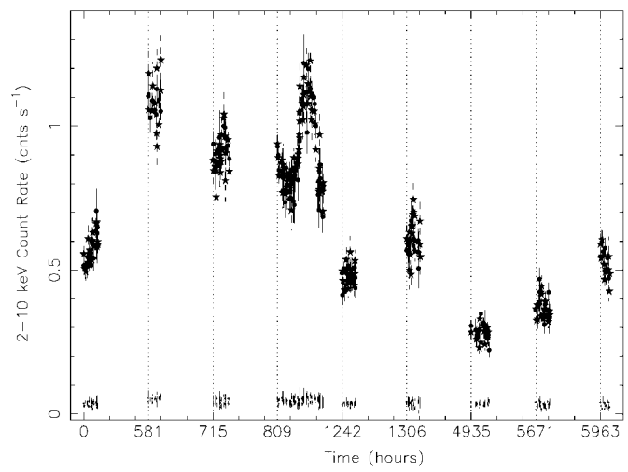
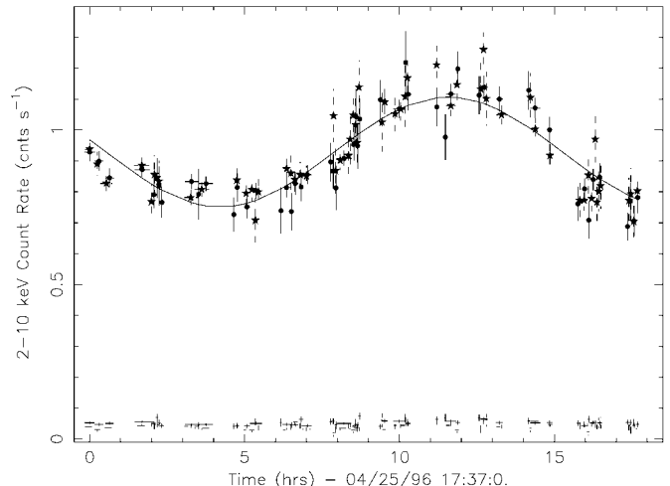
ULXs—Early observations

Slide 10
ULXs—Early observations
1981: Several non-nuclear sources in spiral arm with $L_{X}^{}$> ${10}^{39}$erg/s were found.
1990s: ROSAT found that…
1 in every 5 galaxies had a ULX, and
5-10 in each starburst galaxy observed
Single sources ?
Groups?
Expanding Supernova remnants?
*Whatever process ins forming these very luminous BHs is enhanced when many stars, particularly one of large mass and size, form simultaneously. And the production of the high-brightness X-ray sources goes away as fast as the star formation subsides.
1999: using ASCA, X-1 in M82 was found to vary by up to a factor of four, confirming that this bright source was indeed a single object.
*Over half of ULXs are known to be variable, ruling out the multiple source or SNR hypothesis.
Recent studies show that they don’t seem to be associated with large star clusters and in a few cases are actually HMXBs.
In a 2002 simulation of star clusters, cluster center massive stars merge to form a very massive star >100 $M_{⨀}$ and continue to grow to ~0.1% cluster mass then collapsed into a BH.

Slide 11
ULXs—Temperature problem
For BH accreting near Eddington limit, it would have temperature
Most ULXs have 1-2keV temperature (4-9 times higher)
Some explanations:
--super-Eddington luminosities--
1. IMBHs could be spinning. A factor of 4 could be gained if we use R~$r_{g}$ instead of 6 $r_{g}$
2. Object could be slightly super-Eddingtim with $\dot{m}$ ≈ 3. Given a thin disk then we can gain a factor of 6 in temperature due to seeing radiation produced deep in the disk.
--non-super-Eddington luminosities--
3. The X-rays could be beamed either by reflection off the accretion disk or by a jet.
4. Magnetized accretion disks could produce luminosities greater than $L_{Edd}$ - up to 10x for microquasars.
The isotropic luminosity might only be 1/10 of previous estimates! Previous mass estimates fails to give masses in the IMBH range!

Slide 12
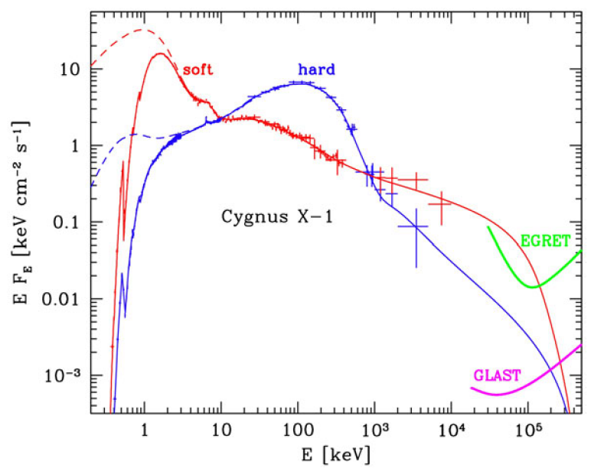
ULXs—Temperature problem
* Increasingly, observers are finding that there often is, indeed, a “soft
X-ray excess” or peak near 0.1 keV in many ULXs, particularly the brightest ones. This may solve the high-temperature problem for many ULXs and revive the
IMBH proposal.
This?
Independent estimates of the isotropic luminosity (e.g., from reflection by, or ionization of, a surrounding nebula) will be needed to counter the beaming argument. And independent estimates of the black hole masses (e.g., via the motion of a binary or additional stellar neighbors) may be needed to finally settle the controversy.

Slide 13
ULXs—in ellipticals
Although ULXs are mostly associated with rapid SF, they are also found in ellipticals.
High luminosity ULXs
Low luminosity ULXs
Occur in globular clusters
Tend to be quite variable.
Possible IMBH candidate?
Don’t seem to be associated with any object.
Don’t vary much.
Example:
A black hole, RZ 2109 was found in a globular cluster in NGC 4472. It emits 4.5*${10}^{39}$erg/s in0.2-12keV with a soft temperature T~0.2keV.
*would be 35 $M_{⨀}$ if radiating at Eddington limit.
More consistent with old, high-luminosity LMXBs.
Almost half of ULXs in ellipticals (particularly those thought to be in their halos) appear to be background sources. So, previous statements that most ULXs in ellipticals lay in their halos were incorrect; instead, most actually lie in the body of the galaxy itself.
?

Slide 14
Outline
1. The definition
Possible candidates:
2. ULXs (Ultra-luminous X-ray sources) in star-forming galaxies
3. Globular cluster cores in our Milky Way and Andromeda
4. Possible IMBH near the center of the Milky Way
5.Low-luminosity Hard X-ray/radio sources in the galactic bulge and other population II systems

Slide 15
Globular clusters—the motivation
1. If ULXs in globular clusters are IMBHs, could we find dormant IMBHs in globular clusters close to us by other means? (Kinematics etc…)
2. Dwarf galaxies have SMBH ~8 × ${10}^{4}$ $M_{⨀}$, might spheroidal globular cluster also harbor BHs? If they also follow the 0.1% mass relation, then they would be ${10}^{3−4}$ $M_{⨀}$.

Slide 16
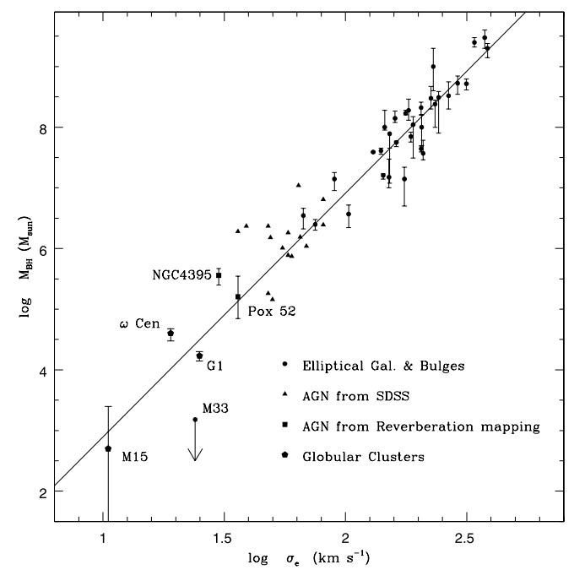
Globular clusters—the 2 massive candidates
2002: G1 cluster (1.5 ×${10}^{7}$ $M_{⨀})$ in Andromeda galaxy was found using velocity profiles to host 2 × ${10}^{4}$ $M_{⨀}$ BH.
2008: A 4 × ${10}^{4}$ $M_{⨀}$ BH was found at the center of Milky Ways’ largest globular cluster ω Cent.
2007 A radio source was found at the center of G1 with $L_{radio}/L_{X}$ similar to other accreting BHs.
Noyola+ 2008
Are they the missing link “IMBH”s that we have been looking for?
Problems:
These two star systems have more in common with the cores
of dwarf elliptical galaxies than with standard globular clusters. For this reason, it
has been suggested that the two are, in fact, partially stripped dwarf ellipticals that
have been captured by their respective spiral hosts.

Slide 17
Globular clusters— another candidate
2002:
Possible detection of ~1700 $M_{⨀}$ black hole in the globular cluster M15 being consistent with M-σ relation.
This could also be explained by “mass segregation” – heavy (>1 $M_{⨀}$) WD & NS sinking to the center of the cluster, mimicking the effects of an IMBH.
These investigators also pointed out that,
if there were an IMBH at the center of a globular cluster, it would not necessarily have a collapsed core like these(?) candidates. Indeed, their simulations showed that clusters with a black hole in the center could have a normal distribution of stars, with a fairly large cluster core radius. The black hole certainly would have an effect on the density of stars near it, but only at a radius well inside 1% of the globular cluster core radius and only affecting a few tens of stars or so
?
If correct, this would call into question all dynamical evidence for IMBHs presented so far. This does not mean that an IMBH is not at the center of many or most globular clusters, only that proving so will be much more challenging than originally anticipated.

Slide 18
Globular clusters— more problems
2008, three globular clusters surveyed (including M15) in radio did not detect a
central black hole radio source in any – down to a Bondi accretion rate of 0.01%.
This is 100 times lower (in Bondi units) than G1.
Therefore, there still is no evidence of any kind that true globular clusters harbor IMBHs in their centers that are anywhere near a mass of 0.1–0.2% of the cluster mass.

Slide 19
Outline
1. The definition
Possible candidates:
2. ULXs (Ultra-luminous X-ray sources) in star-forming galaxies
3. Globular cluster cores in our Milky Way and Andromeda
4. Possible IMBH near the center of the Milky Way
5.Low-luminosity Hard X-ray/radio sources in the galactic bulge and other population II systems

Slide 20
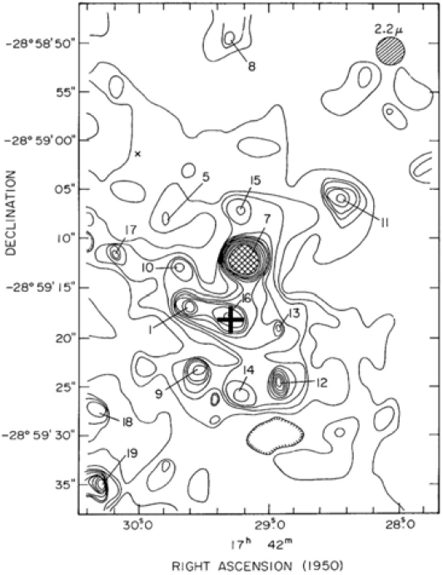
The galactic center—historical background
1975: 19 IR sources found near galactic center.
Later 0.5’’ resolution imaging showed that
1. IRS 13 (~0.2pc from SMBH)
2. IRS 16 (~0.1pc from SMBH)
3. Group of bright stars centered on the SMBH (~0.2pc)
*all appear to be very young, ~Myr
0.1pc~10^6Rs
Stars should not be able to form inside 10pc of the strong, tidal gravity of the SMBH.
It would take Gyrs for stars formed >10pc away to migrate inward.
How did those young stars wind up so close to the SMBH?

Slide 21
The galactic center—the theoretical aspect
In 2003, theorists conclude that these young stars indeed could have migrated into the center in a few million years, but only if they remained bound in a compact, very heavy cluster of stars that rapidly sank toward the center of the Galaxy.
If it were only a star cluster, then it would have been torn apart well beyond there they lie now.
Another BH of ~${10}^{3}$~ ${10}^{4}$ $M_{⨀}$ would be needed to hold them together.
The scenario:
1. A massive ~${10}^{6}$ $M_{⨀}$ star cluster formed it’s own IMBH ~${10}^{3}M_{⨀}$
2. The cluster sank toward the SMBH via dynamical friction
3. Somewhere inside 0.1~0.2pc the SMBH’s tidal forces finally overcome the binding of the IMBH and stripped the cluster.
Observed features (prev. page)
1. IRS 13 (~0.2pc from SMBH)
2. IRS 16 (~0.1pc from SMBH)
3. Group of bright stars centered on the SMBH (~0.2pc)

Slide 22
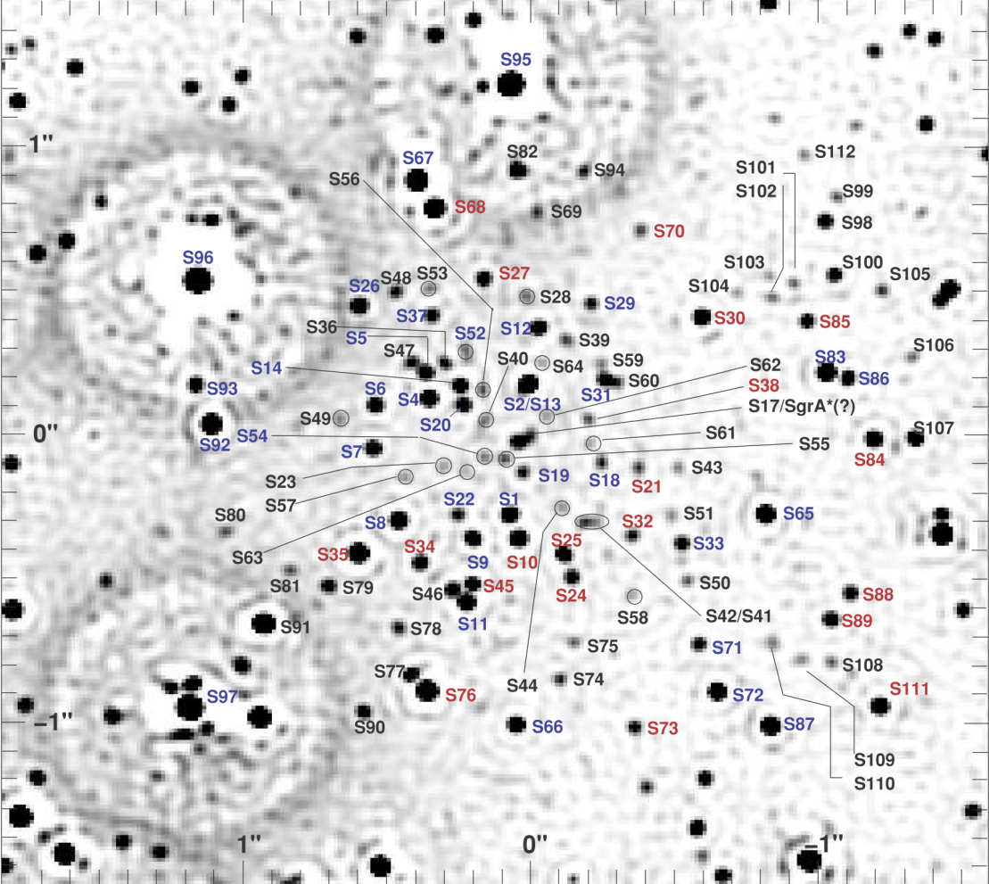
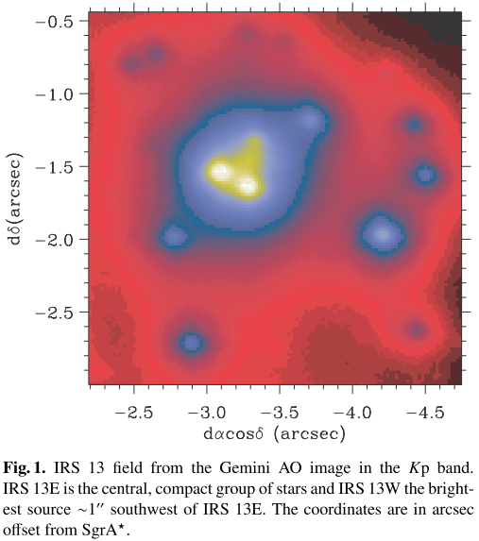
The galactic center—detailed observations
In 2004, IRS 13E was resolved into 20 distinct stars with 0.04’’ NIR imaging.
Unlike IRS 16, IRS 13E is very compact and not being tidally disrupted into a ring of stars by the SMBH.
By following the stellar motions, the dark mass was found to be greater than ${10}^{3}M_{⨀}$.
ApJ, 692, 1075 (2009)
Stripped IRS 16
Based on these preliminary results, Portegies Zwart and his group have predicted that there may be as many as 50 additional one-thousand solar mass IMBHs within 10 pc of our central SMBH.
IRS 13E
A&A, 423, 155 (2004)

Slide 23
Outline
1. The definition
Possible candidates:
2. ULXs (Ultra-luminous X-ray sources) in star-forming galaxies
3. Globular cluster cores in our Milky Way and Andromeda
4. Possible IMBH near the center of the Milky Way
5.Low-luminosity Hard X-ray/radio sources in the galactic bulge and other population II systems

Slide 24
Hard X-Ray Sources in the Galactic Bulge
Very bright, soft sources (ULXs)
IMBH
Emitting no detectable radiation (globular cluster cores, IRS 13E)
How about sweeping up small amounts of gas and shining faintly?
In Chap. 11, we will learn that the Bondi accretion rate for this process of sweeping
up gas is:
Taking typical ${10}^{3}M_{⨀}$ IMBH mass, 70km/s as Galactic bulge $σ_{v}$, and 100${cm}^{−3}$ as typical number density, and assuming ADAF model for accretion at low rates (sec 12.2.2), the luminosity would be
--this estimate is of course strongly dependent on the parameters- -
*If $σ_{v}$ were increased to 150km/s then the luminosity would drop by 2 orders of magnitude.
*If in the case we take a ${10}^{4}M_{⨀}$ BH, then the luminosity would increase by 3 orders of magnitude.

Slide 25
Hard X-Ray Sources in the Galactic Bulge
What would these weak X-ray sources look like?
By analogy of weak X-ray binaries and LLAGNs, they should be
*hard X-ray sources with
*a large fraction of their emission in the 10-100 keV region
According to ADAF model, they could remain hard X-ray sources until they reach $\dot{m}$~0.03-0.1
They would appear as hard X-ray sources with Lx~${10}^{34−37}$erg/s
INTEGRAL & Chandra show:
~60 hard sources down to ${10}^{35}$ erg/s within 1kpc of the Galactic center,
2000 sources down to ${10}^{31}$ erg/s within ~20kpc,
If Portegies Zwart’s team’s estimates are correct,
then several hundred of these hard, weak X-ray sources (10–20% of them) could be IMBHs. This fraction would not contradict current ideas that most of these faint sources are cataclysmic variable binaries with a magnetized white dwarf and a MS star.

Slide 26
Radio searches for Low-Luminosity miniquasars?
Tom Maccarone and his team suggest that an even better method of finding low-luminosity miniquasars would be to search for them in the radio region, at 5GHz, the predicted radio flux would be

Slide 27
Summary I don’t think I can make it any more concise here…

